Slide 1
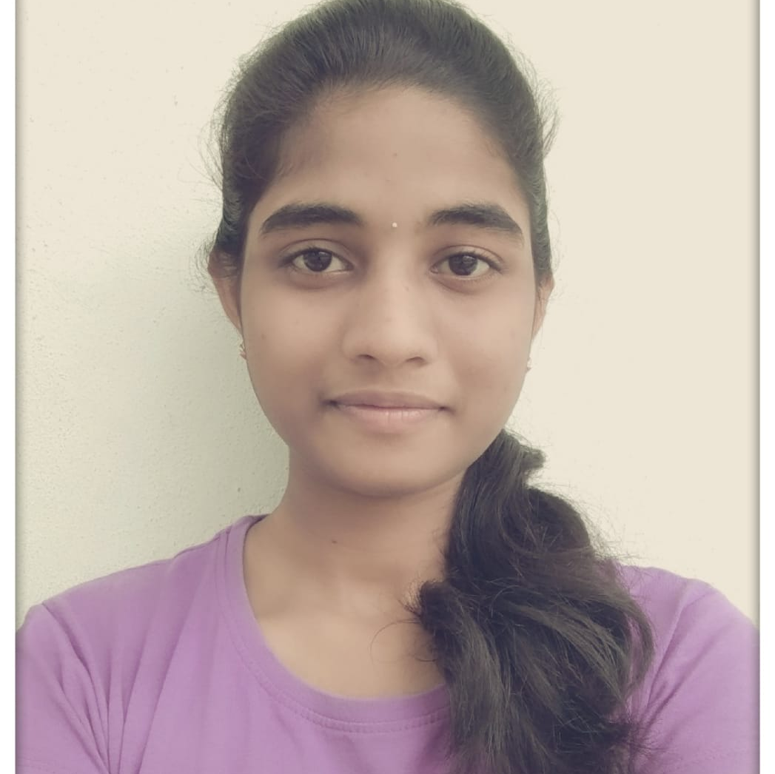



Sowmya Gulla
Analyst/Software Engineer
Bachelor of Engineering
Computer Science : 2017 - 2021
Skills
Java | Java Basics, OOPS, Generics, Collections, Arrays, Loops, Lambda Exp, Stream API Junit, Mockito
Spring Core | IOC & Dependency Injection, Auto wiring, Spring AOP
Spring MVC | Annotations, Data Binding
Spring REST | REST controllers, Implementation of GET, POST, PUT & DELETE, Bean Validation & Exception Handling, Testing Services, Controller & Repository layer
Spring Boot | Spring Boot Starters, annotations, Swagger
Spring Security | Spring Security & JWT
Spring Cloud | Microservices, Service discovery using Eureka, API Gateway.
Angular | Components, Pipes & Services, Routing, Angular Forms, Angular material & Validation, Testing using Jasmine & Karma
Database | No SQL database - MongoDB
UI Tech | HTML 5 & CSS 3, JavaScript, ES6 & TypeScript, Angular
Tools | Postman, Eclipse, Spring Tool Suite, VS Code, Git
Bangalore
Sowmya.gulla@capgemini.com
+91 7013713272
A4
Java Full Stack Developer
Hands on experience in creating Microservices using Spring boot, Spring Security, Spring Cloud API Gateway, Eureka server.
Proficient in creating web applications in Angular with Angular Reactive forms, Angular routing, Bootstrap.
Implemented case study using Spring boot, Angular and No SQL Database (MongoDB).
Implemented Mockito Unit Testing in my case study.
Understanding of deploying spring boot applications in AWS Cloud environment.
Team Player who communicates effectively.
Hotel Management Application
Completed the Hotel Management Application case study using Java Full Stack with Angular.
Implemented Microservices using Spring Boot, Spring Cloud and connected them using Service discovery i.e. Netflix Eureka and also implemented API Gateway and Swagger.
Frontend is developed with Angular 12, using Angular material and bootstrap.
Backend with MongoDB
Completed Java Full Stack Angular training
Check out my work on GitHub & Video Profile

